Slide 1
Creative Coders (competitive programming ranking system)
PREPARED BY:
ADITYA CHOUDHARY HIMANSHU
ACHIN VARSHNEY UDIT AGRAWAL

Slide 2
Introduction
ACM International Collegiate Programming Contest (abbreviated as ACM-ICPC or just ICPC) is an annual multi-tiered competitive programming competition among the universities of the world.
But their isn’t a feature on various coding platforms like topcoder , codechef etc that help prepare for ICPC Programming contests in which users can compete within their college, see other programmer's progress .
This system has been designed to provide all the features one need to know about other programmers of their college.

Slide 3
Purpose
It is a dynamic ranking system that ranks users on the basis of their scores in a live contest college-wise.
It also maintains the ranking of the users based on their performance in the past contests.
It provides comparative rankings to colleges based on their average scores.
It improves upon the coding skills by enabling users to discuss their problems with the users of their college or other colleges.

Slide 4
DATA FLOW DIAGRAM

Slide 5
user
Request for rank
ranking system
Return result
Show rank
Request for update/delete user
admin

Slide 6
Functionality Flow-chart

Slide 7
start
If college selected
no
Live score
Enter college and submit
Add user/
Admin
choose
yes
ranking
Enter contest and submit
yes
If college selected
no
Display relative ranks in college
Enter college and submit
reset
choose
remove
Display global ranks
View college ranking
End
Display college ranks

Slide 8
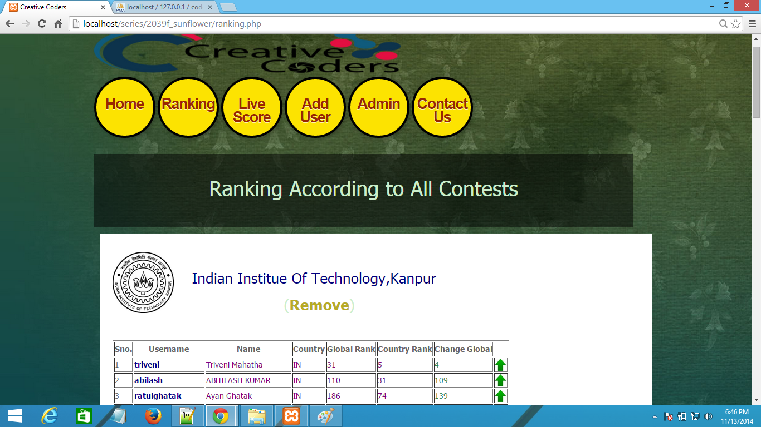

Slide 9
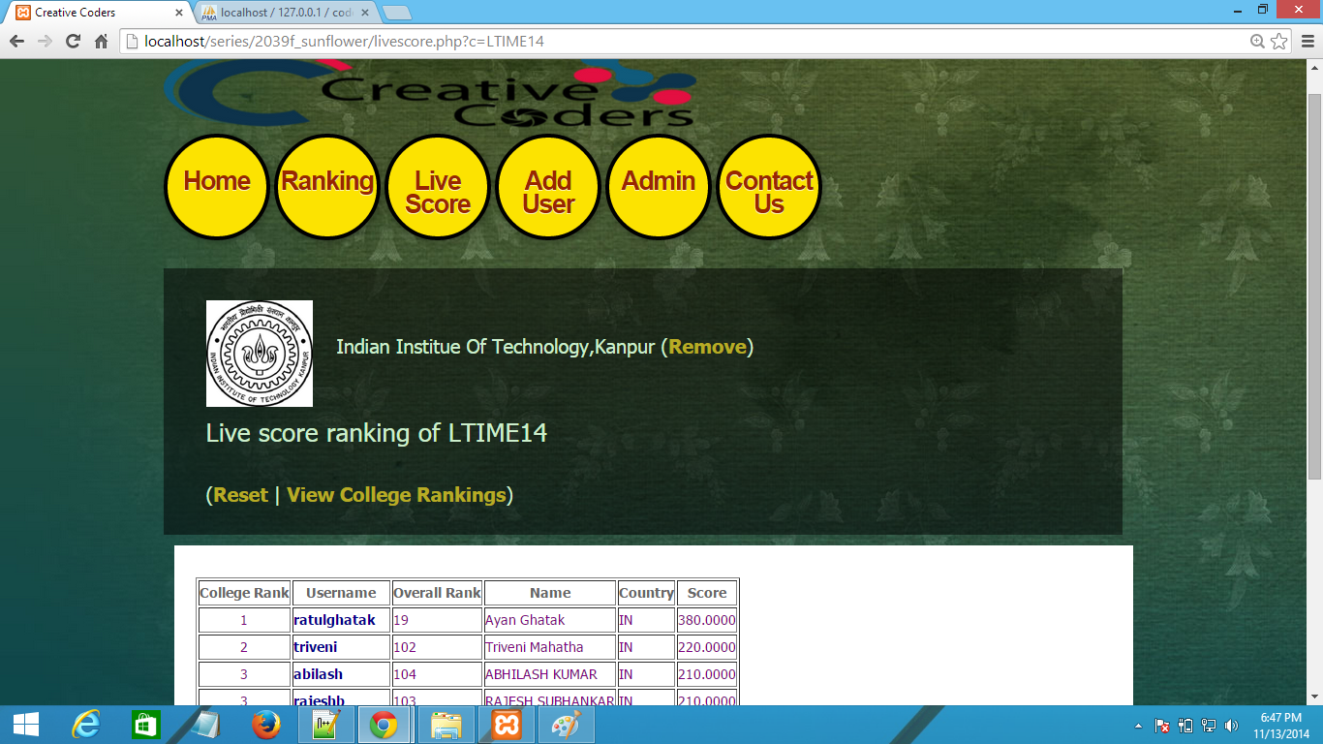

Slide 10
Add user
User submit credentials
Any credential invalid/empty
Yes
no
Yes
User name already exist
no
User added successfully
End

Slide 11
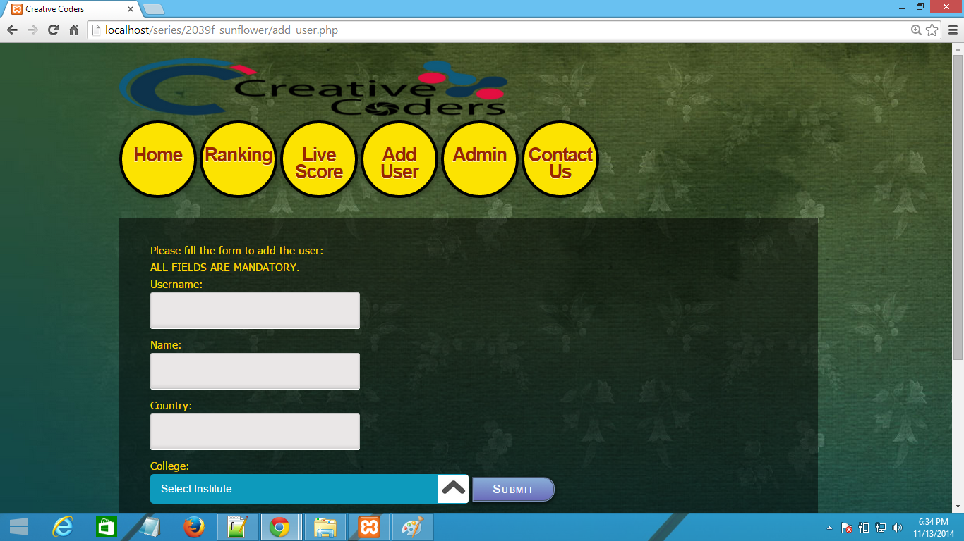

Slide 12
Admin
Logout
Admin submit credentials
Any credential invalid/empty
Yes
C
no
Choose
Update Org
Admin put Credentials
Delete User
Update Rank
Admin put Credentials
Yes
Yes
Admin put Credentials
Yes
Any credential invalid/empty
Any credential invalid/empty
Any credential invalid/empty
no
Organization Updated Successfully
no
Delete User
no
C
Update Rank Successfully
C

Slide 13
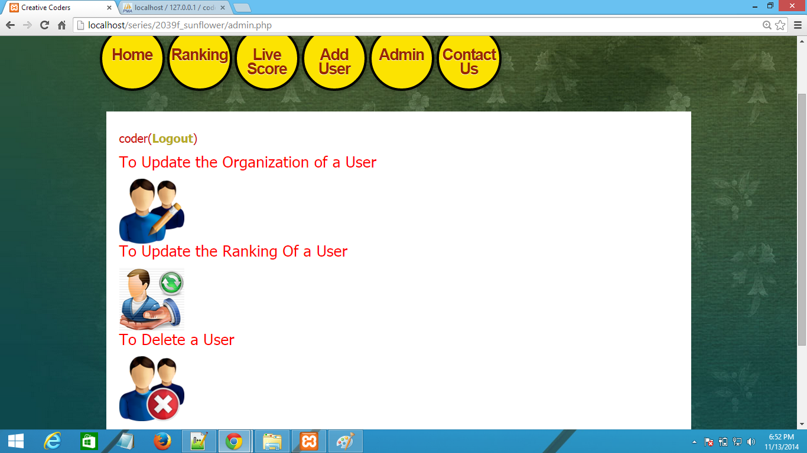

Slide 14
Entity-Relationship Model

Slide 15
Handle
Country
Name
name
Global Rank
Participates in
User
Contest
Organized by
Works at
Contest Rank
Score
Current Rank
Updated by
Handle
Name
Admin
Has a
College/Institute
Password
Updated/deleted by

Slide 16
THANK YOU

